Slide 1
Hallo dit is en powerpoint over spelletjes top 10
Senne andres

Slide 2
De top10
Spelletjes
Ps3 en ps4

Slide 3
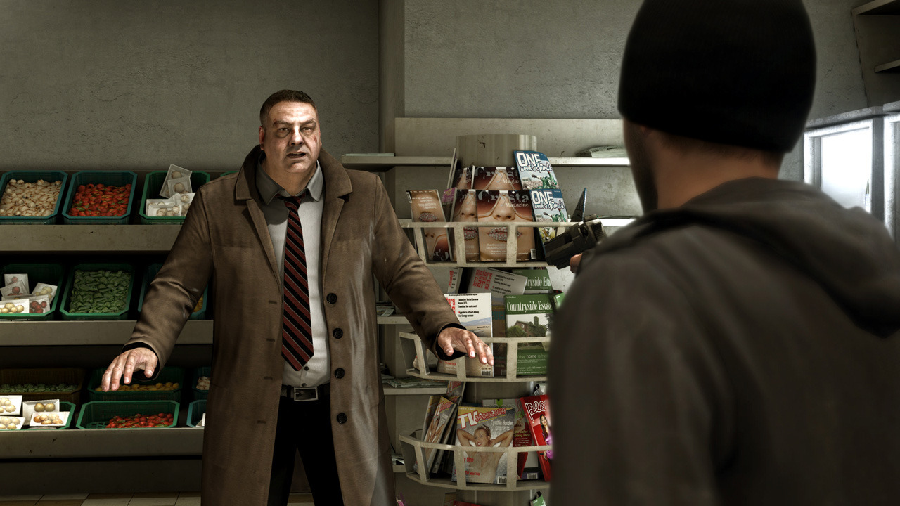
10
Heavy rain

Slide 4
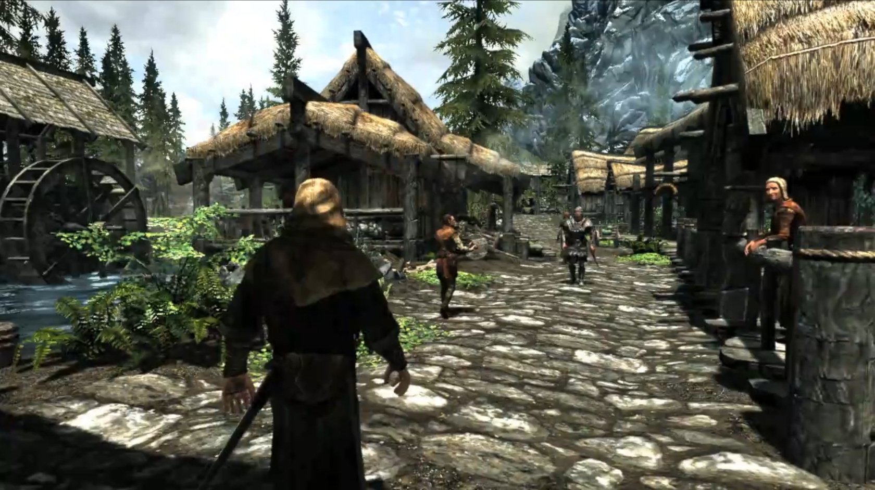
9
The elder scrolls v: skyrim

Slide 5
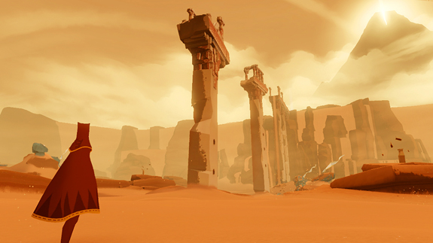
8
journey

Slide 6
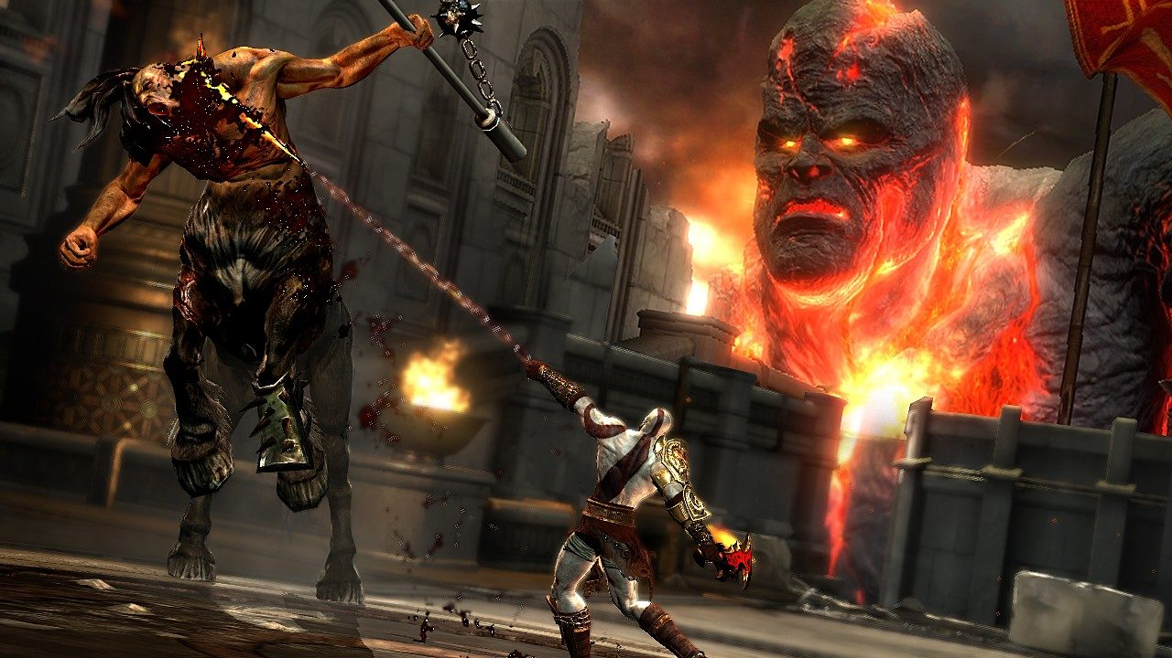
7
God of war 3

Slide 7
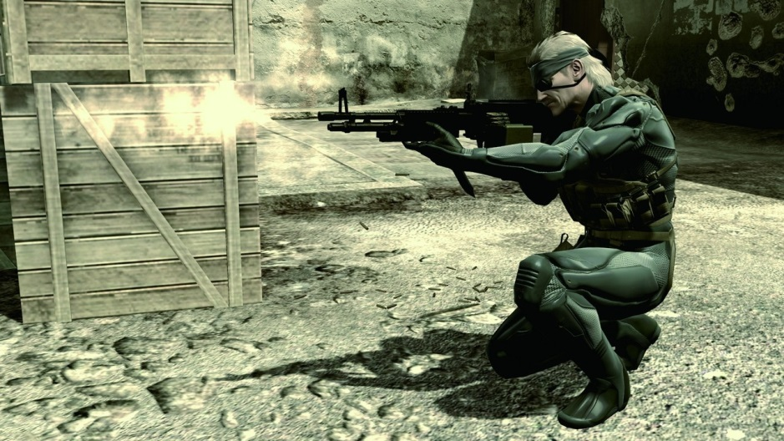
6
Metal gaer solid: guns of the patriots

Slide 8
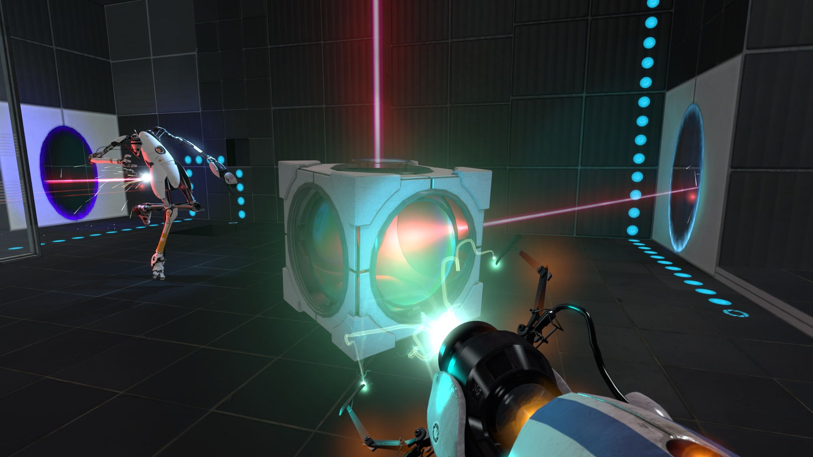
5
Portal 2

Slide 9
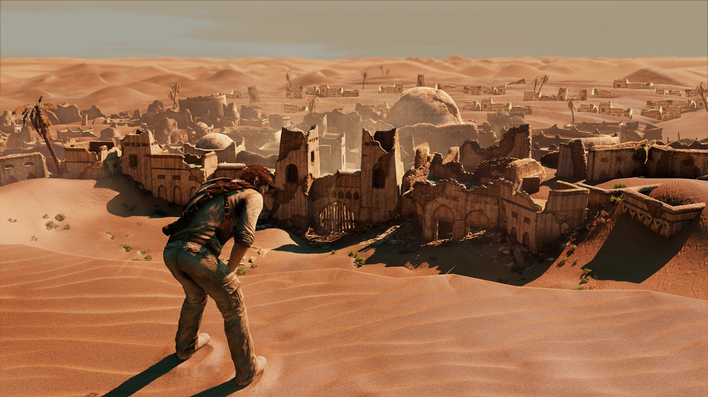
4
Uncharted 3: drake ‘s deception

Slide 10
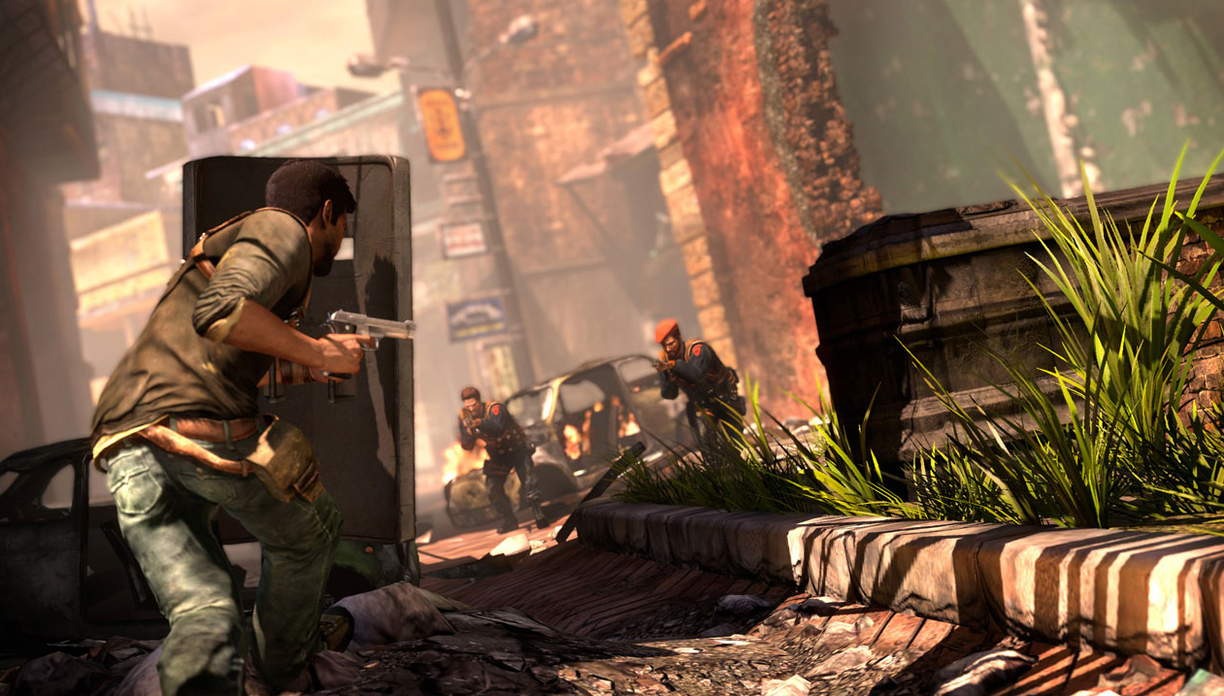
3
Uncharted 2: among thieves

Slide 11
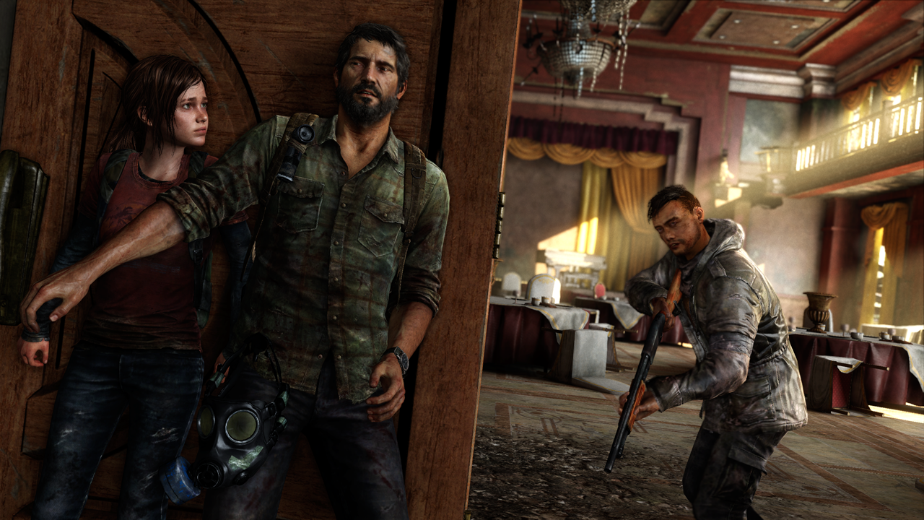
2
The last of us

Slide 12
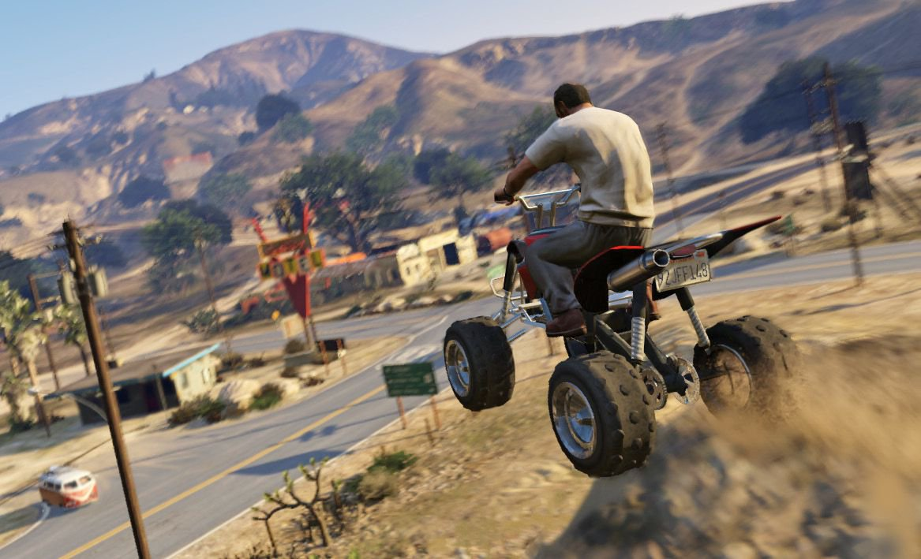
1
Gta 5

