Slide 5
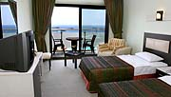
Hotel Tatlises, Kusadasi

