Slide 1
Egypte
Onze droomvakantie…

Slide 2
De verschillende keuzes
Splashworld Waterworld ****
Concorde El Salam *****
Sentido Mamlouk Palace Resort *****

Slide 3
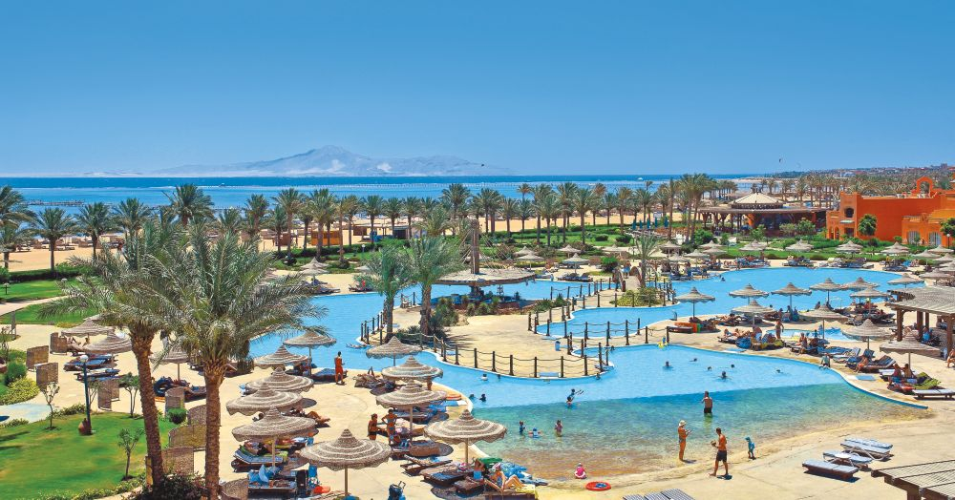
Splashworld Waterworld ****
Keuze 1…

Slide 4
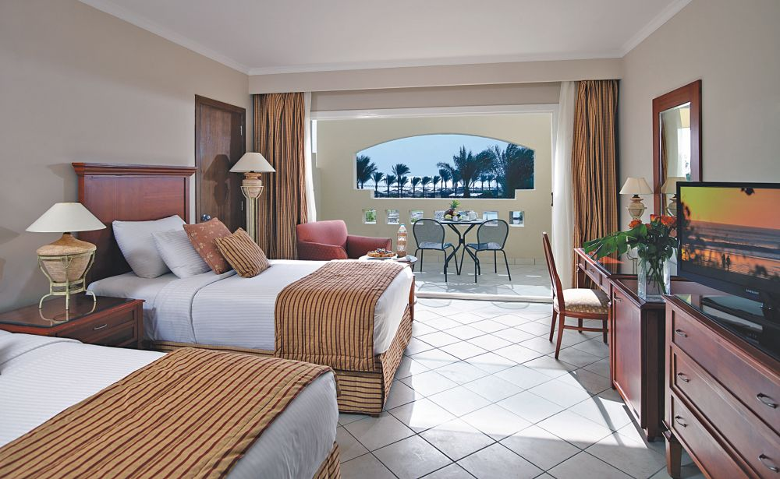
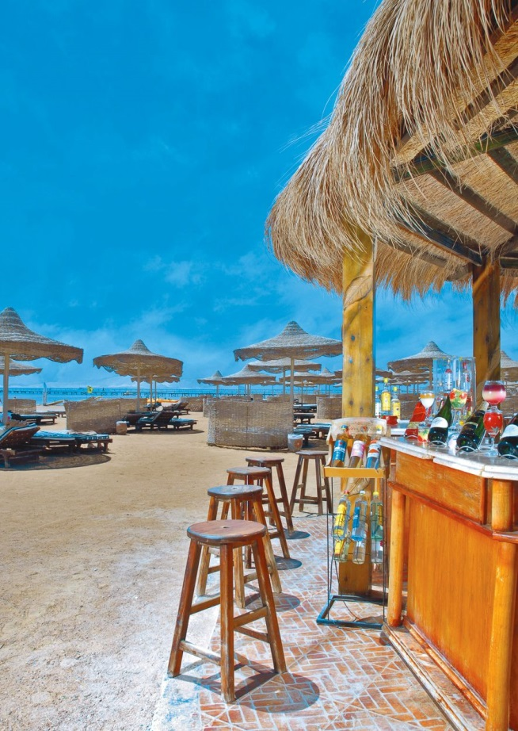
Splashworld Waterworld ****
€ 1 476,80 per week

Slide 5
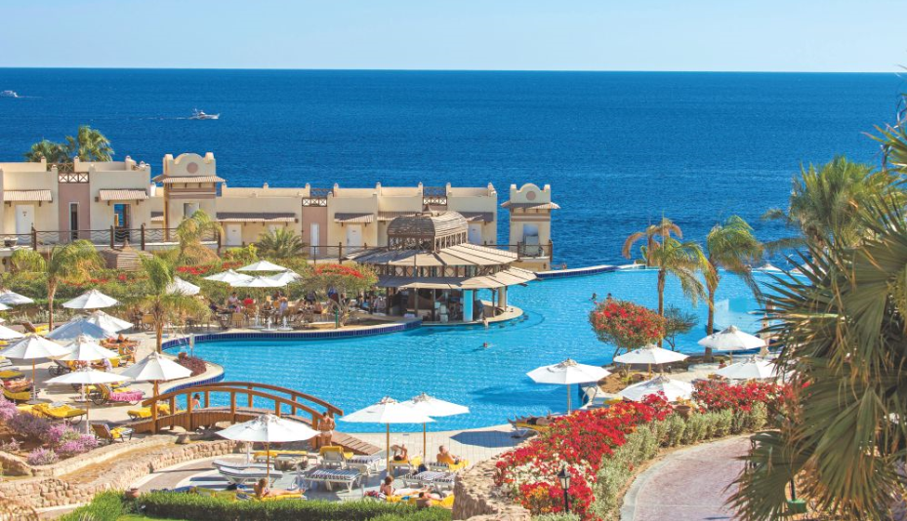
Concorde El Salam * * * * *
Keuze 2…

Slide 6
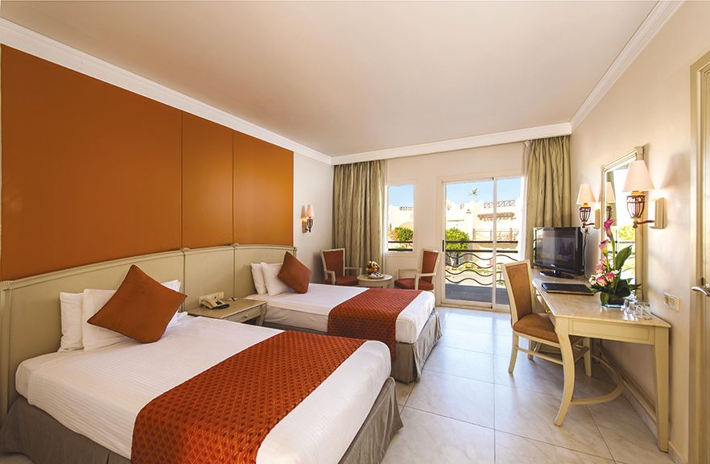
Concorde El Salam * * * * *
€ 947,83 per week

Slide 7
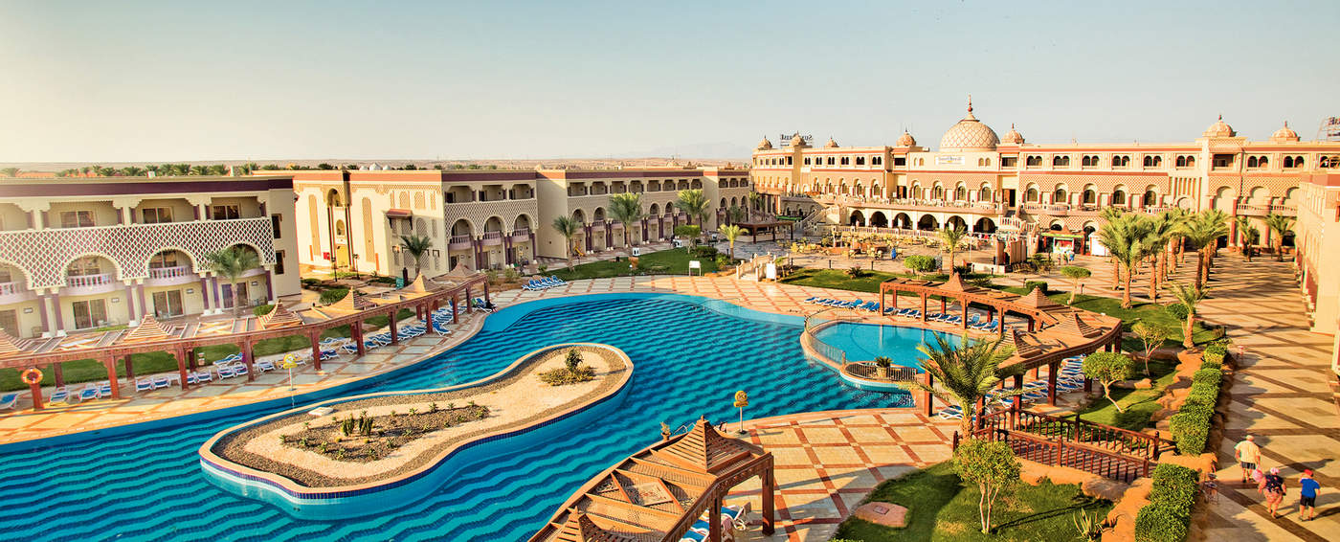
SENTIDO Mamlouk Palace Resort *****
Keuze 3…

Slide 8
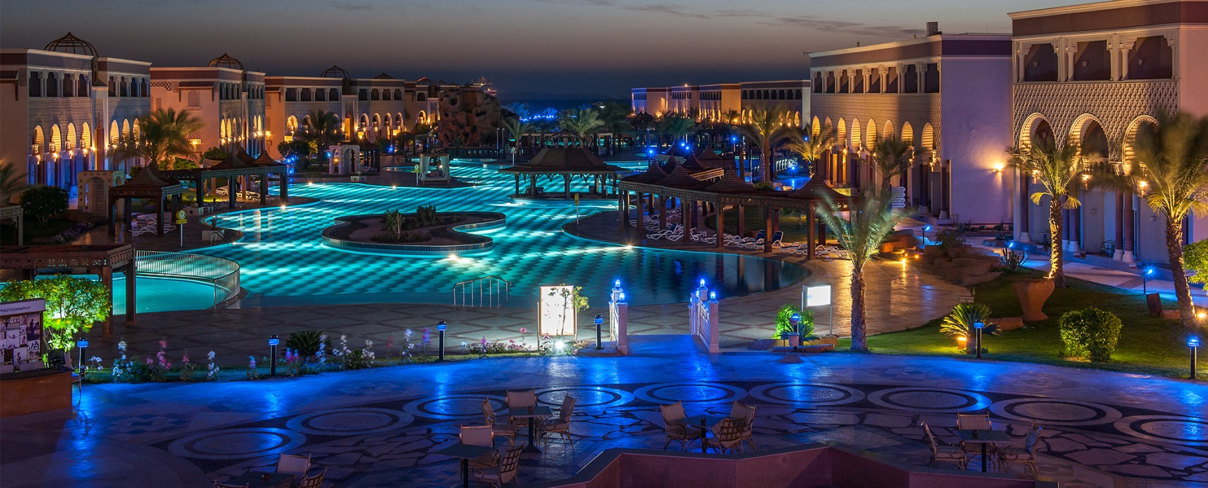
SENTIDO Mamlouk Palace Resort *****
€ 1 451 per week

Slide 9
En we gaan naar…
Keuze 3
SENTIDO Mamlouk Palace Resort *****

Slide 10
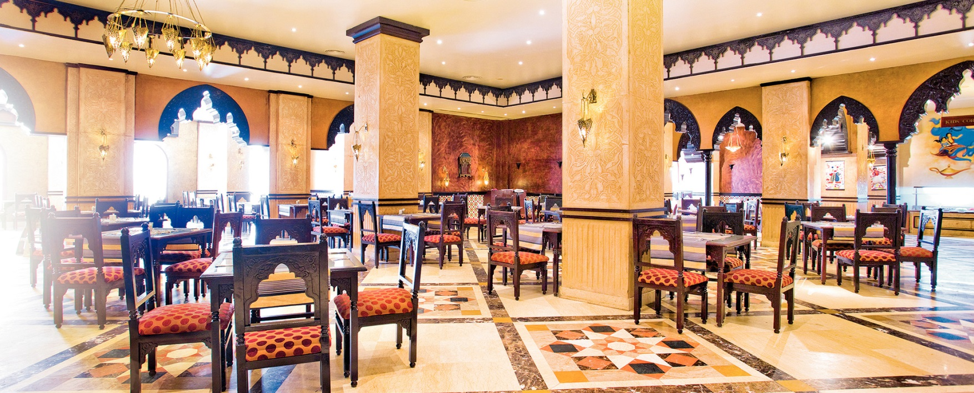
SENTIDO Mamlouk Palace Resort *****

Slide 11
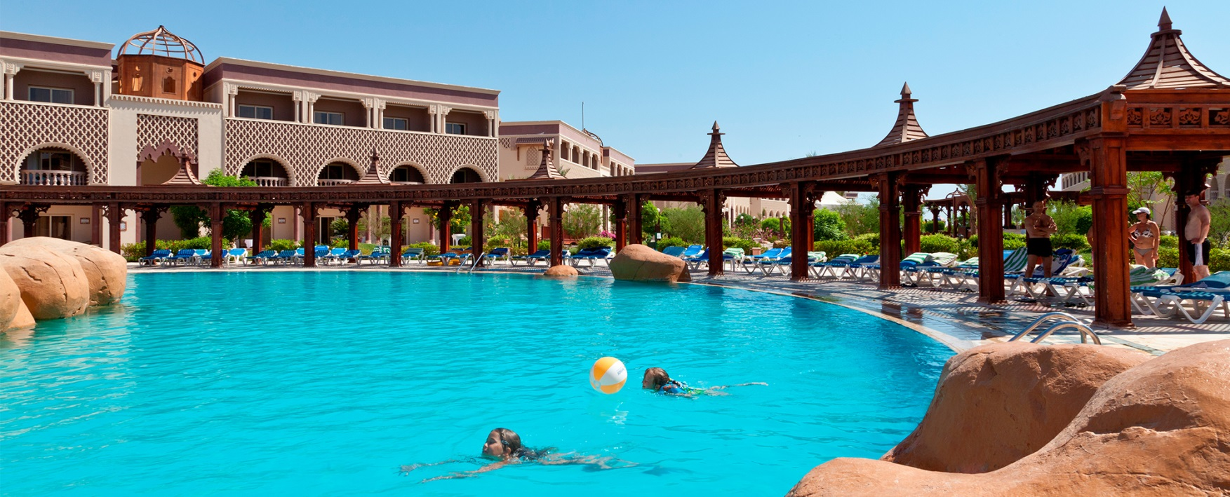
SENTIDO Mamlouk Palace Resort *****

Slide 12
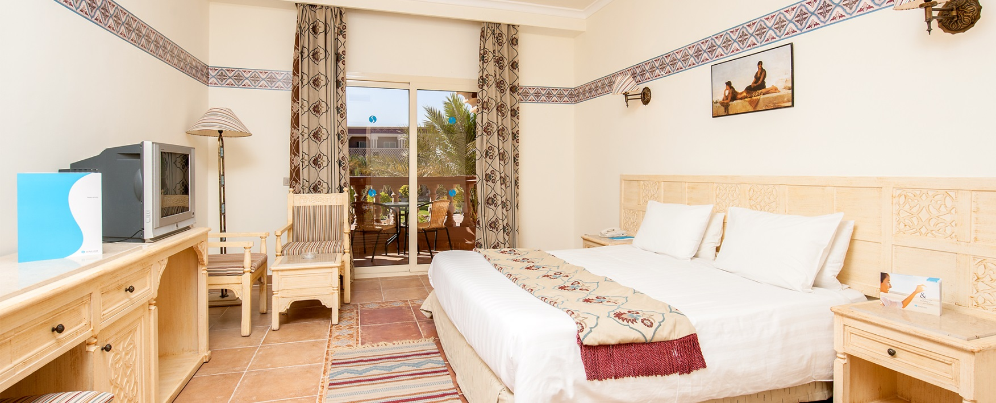
SENTIDO Mamlouk Palace Resort *****

Slide 13
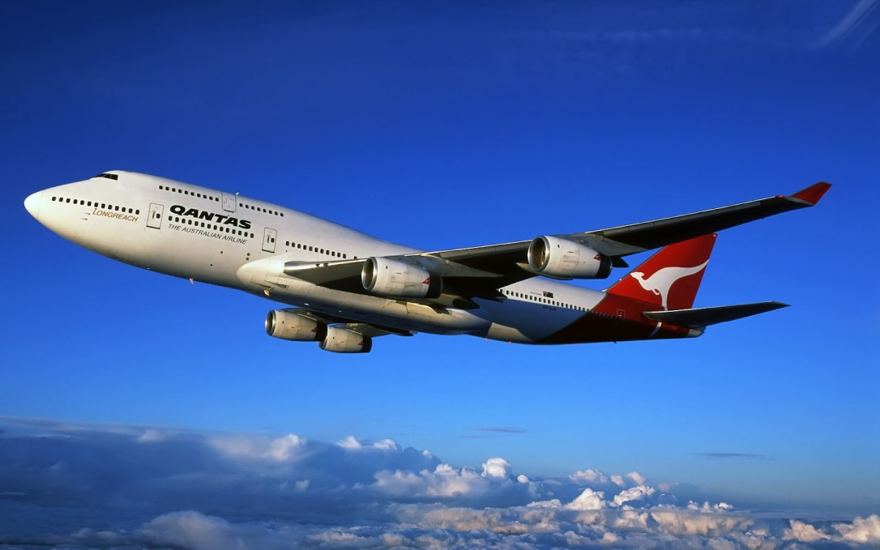
THE END

