Slide 1
WORLD PRESS PHOTO’S
By: Sander Vandenberk

Slide 2
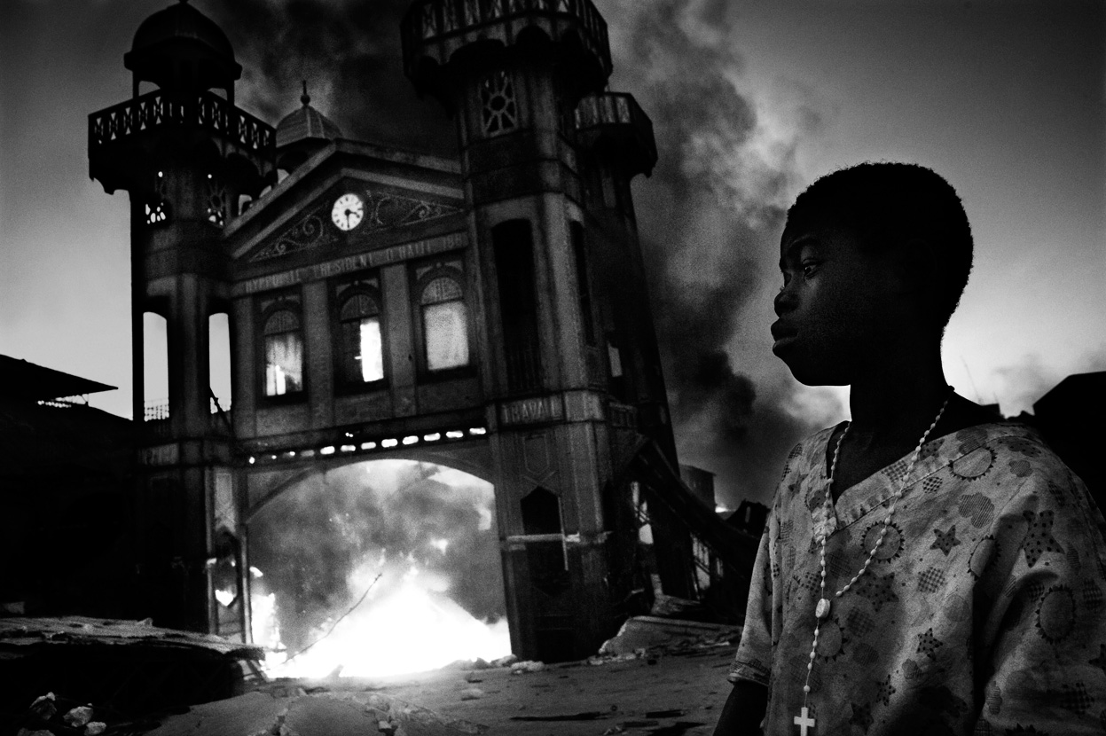
HAÏTI AFTERMATH: Ricardo Venturi 2011 http://www.worldpressphoto.org/#header

Slide 3
SLACHTOFFER VAN OORLOG Jodi Bieber 2010 http://www.worldpressphoto.org/

Slide 4
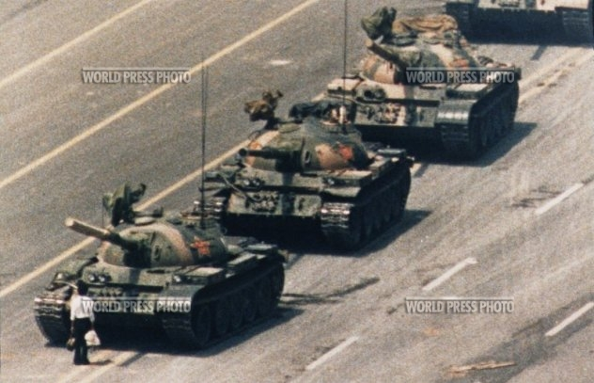
PROTEST TEGEN TANKS Google/world press photo

Slide 5
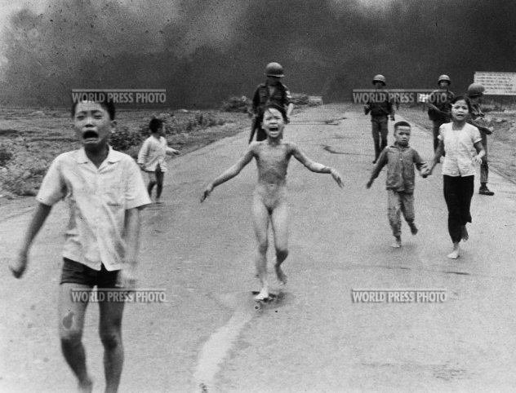
NAPALM BOMBARDEMENT Google/world press photo

Slide 6
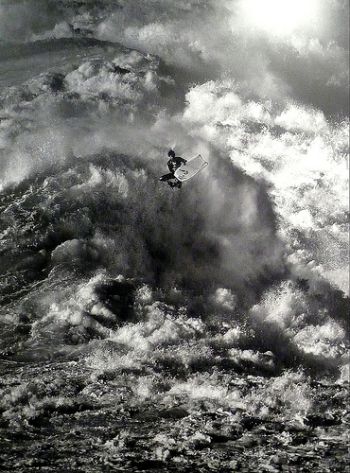
SURFER Juan Pablo Valenzuela 2008 http://www.flickr.com/photos/vikingospub/3094714281/

