Slide 1
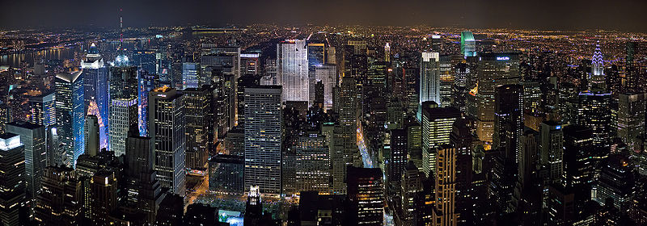
New York 11/09/11

