Slide 1
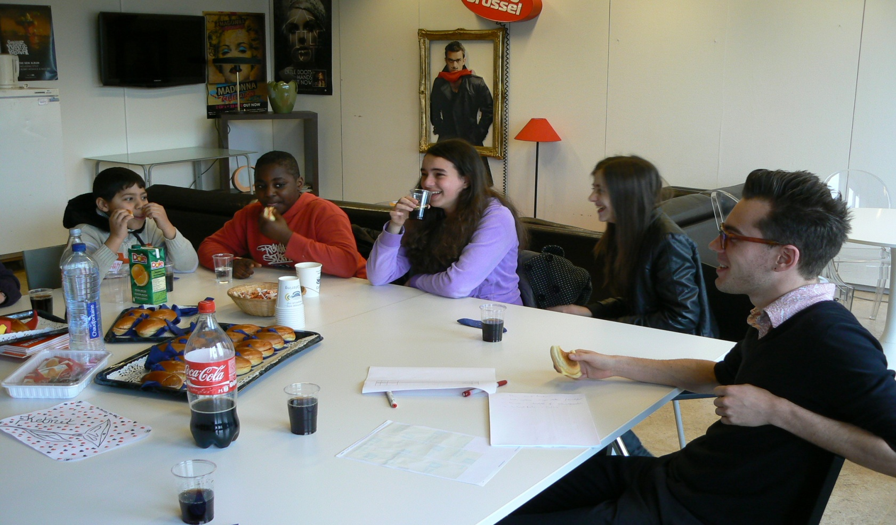
KETNET, here we come!

