Slide 1

Photo by Richard Masoner / Cyclelicious - Creative Commons Attribution-ShareAlike License https://www.flickr.com/photos/99247795@N00
Created with Haiku Deck

Slide 2
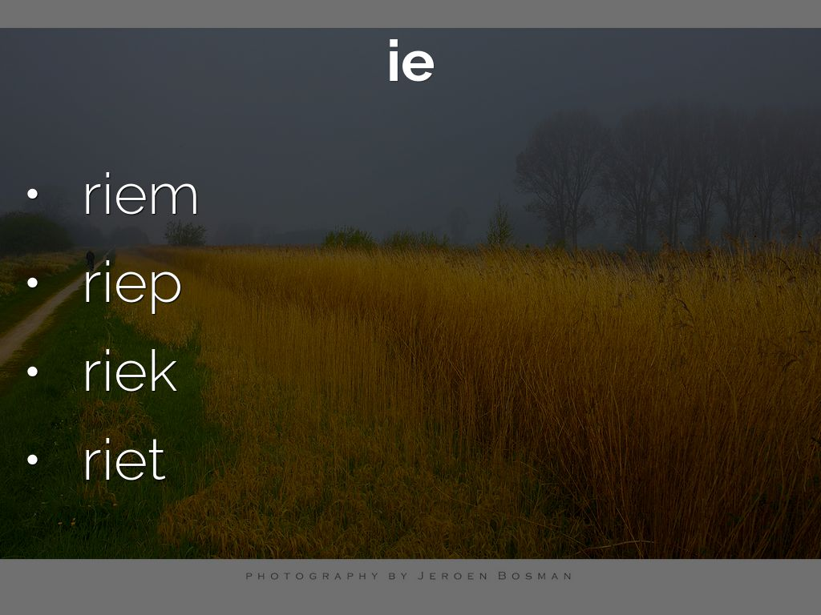
Photo by Jeroen Bosman - Creative Commons Attribution-NonCommercial-ShareAlike License https://www.flickr.com/photos/94188217@N00
Created with Haiku Deck

Slide 3

Photo by Wanja Krah - Creative Commons Attribution-NonCommercial-ShareAlike License https://www.flickr.com/photos/33443636@N05
Created with Haiku Deck

Slide 4


Slide 5
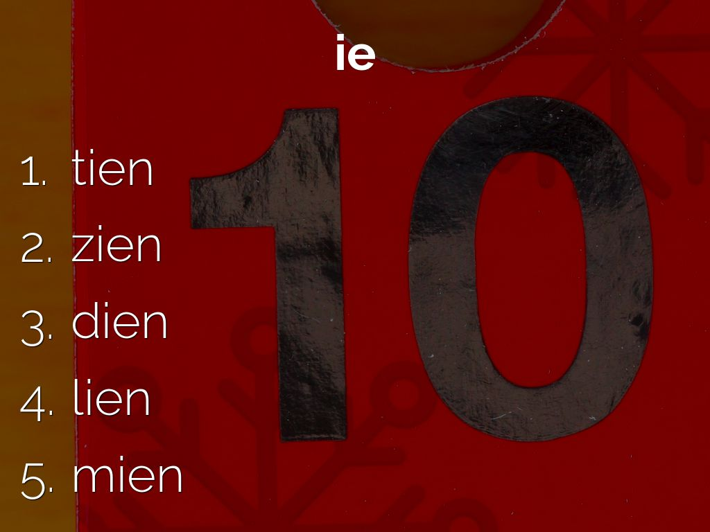
Photo by Leo Reynolds - Creative Commons Attribution-NonCommercial-ShareAlike License https://www.flickr.com/photos/49968232@N00
Created with Haiku Deck

Slide 6

Photo by Robin Geschonneck - Creative Commons Attribution-NonCommercial-ShareAlike License https://www.flickr.com/photos/52299769@N04
Created with Haiku Deck

