Slide 1


Slide 2
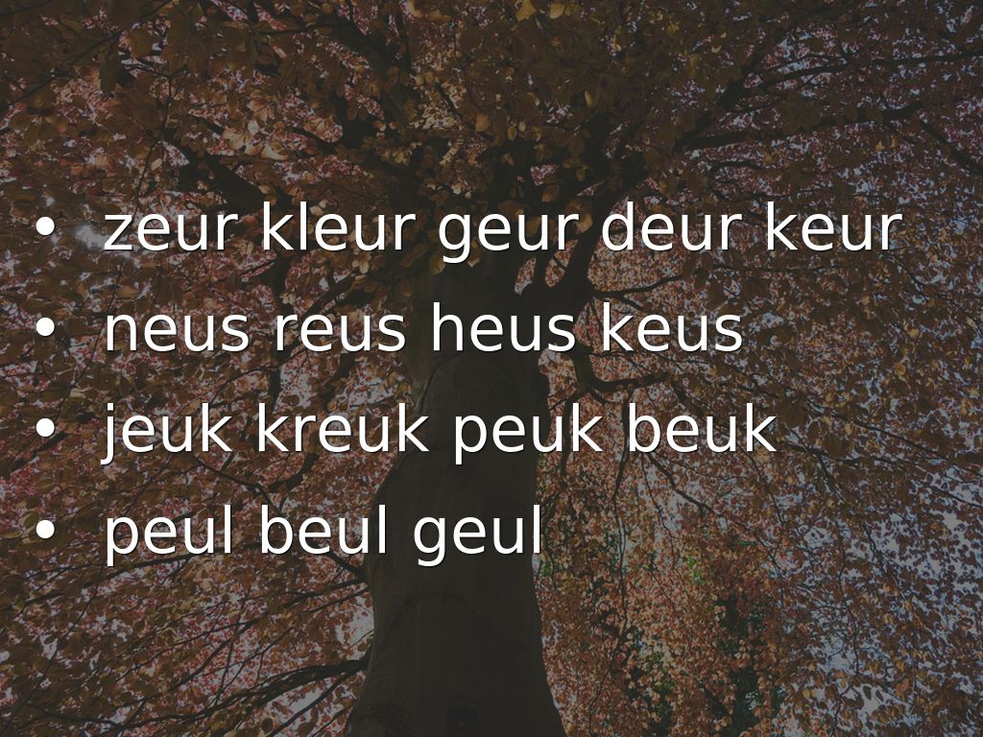
Photo by Birgit Speulman - Creative Commons Attribution-NonCommercial-ShareAlike License https://www.flickr.com/photos/56276379@N00
Created with Haiku Deck

Slide 3
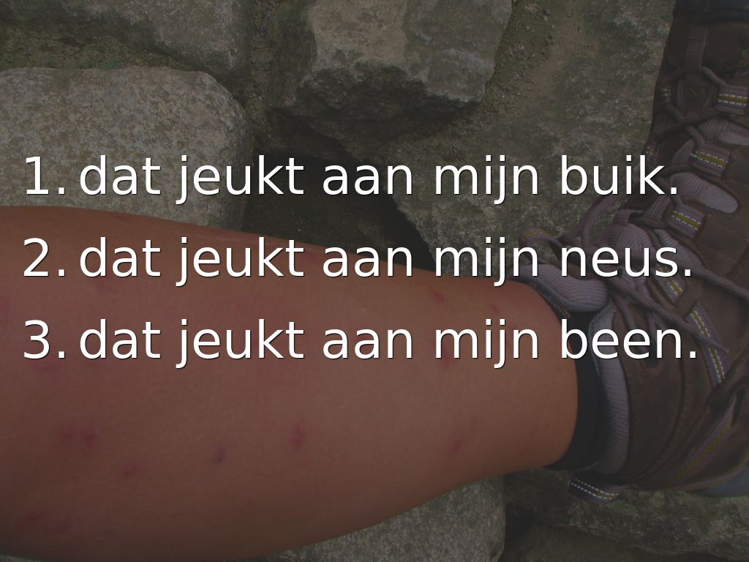
Photo by Eveline314 - Creative Commons Attribution-NonCommercial License https://www.flickr.com/photos/80394953@N00
Created with Haiku Deck

Slide 4
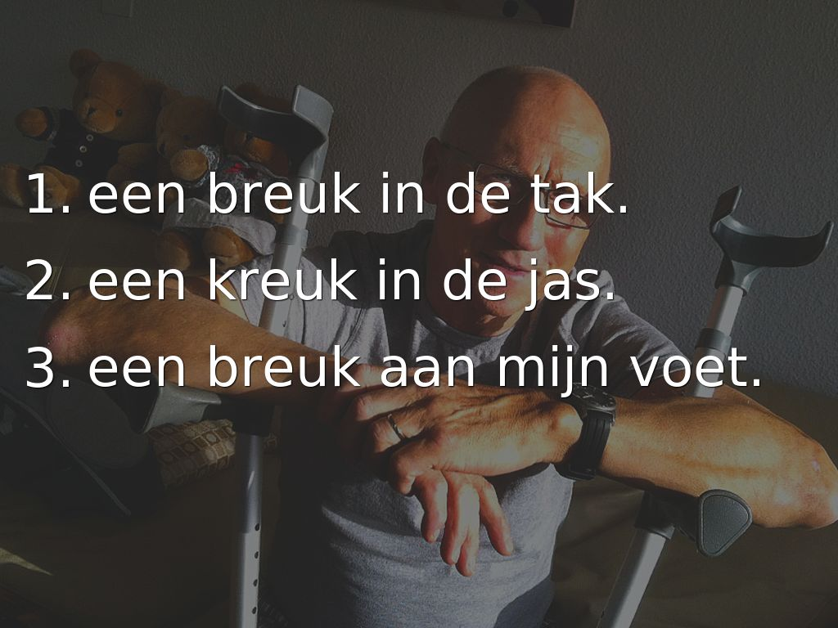
Photo by Rob Duin & Friends - Creative Commons Attribution-NonCommercial-ShareAlike License https://www.flickr.com/photos/8749006@N06
Created with Haiku Deck

Slide 5
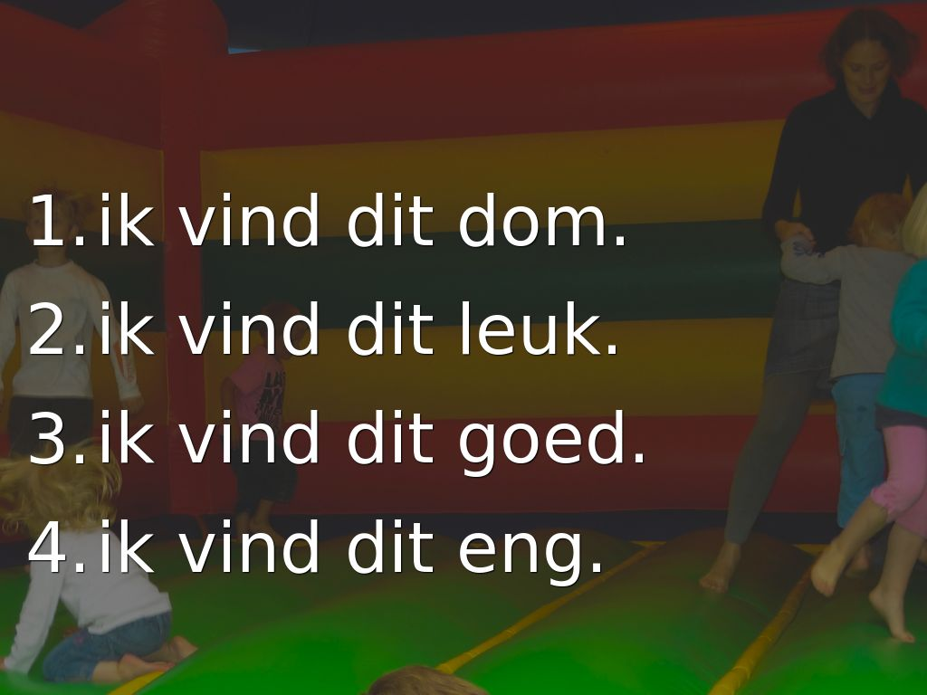
Photo by Wijkverenigingtuinwijk - Creative Commons Attribution-ShareAlike License https://www.flickr.com/photos/98914488@N07
Created with Haiku Deck

Slide 6
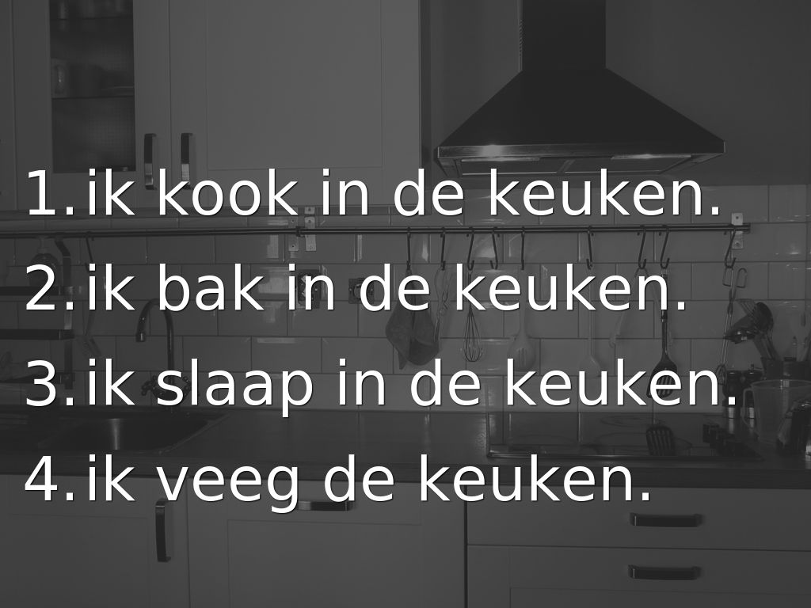
Photo by Breuls - Creative Commons Attribution-NonCommercial-ShareAlike License https://www.flickr.com/photos/56562542@N00
Created with Haiku Deck

Slide 7
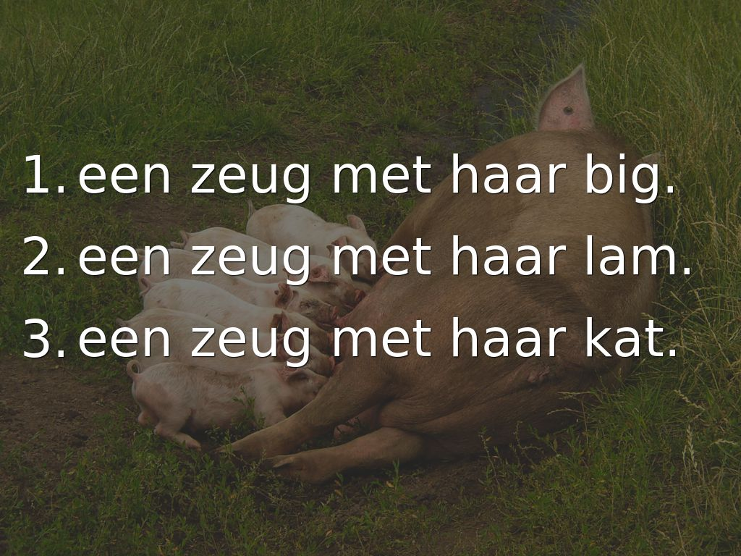
Photo by Compassion in World Farming Nederland - Creative Commons Attribution License https://www.flickr.com/photos/40025815@N08
Created with Haiku Deck

