Slide 1
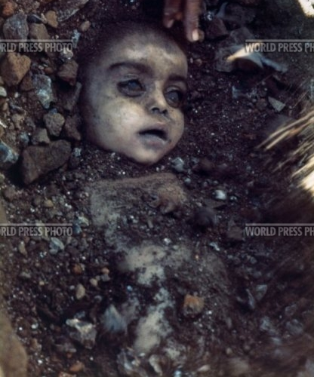
Child killed by the poisonous gas leak in the Union Carbide chemical plant disaster.
http://www.archive.worldpressphoto.org/search/layout/result/indeling/detailwpp/form/wpp/q/ishoofdafbeelding/true/trefwoord/year/1984
De fotograaf: Pablo Bartholomew

Slide 2
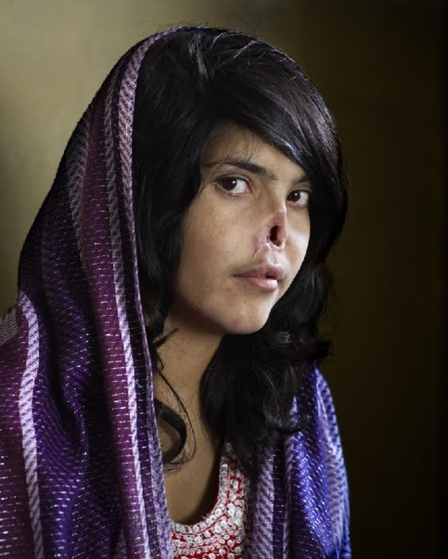
Vrouw verliest neus

